Slide 2
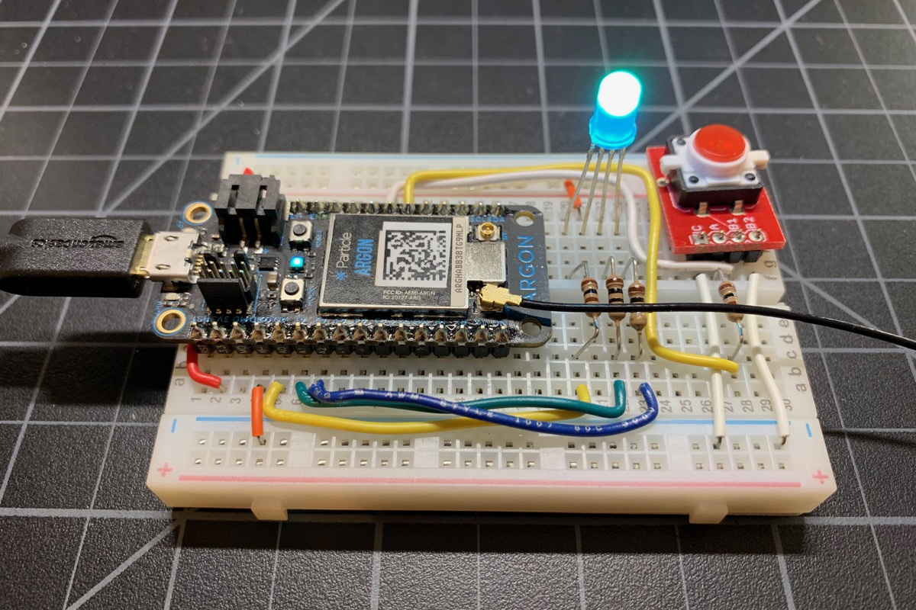
Breadboard with Solid Wires

Slide 3
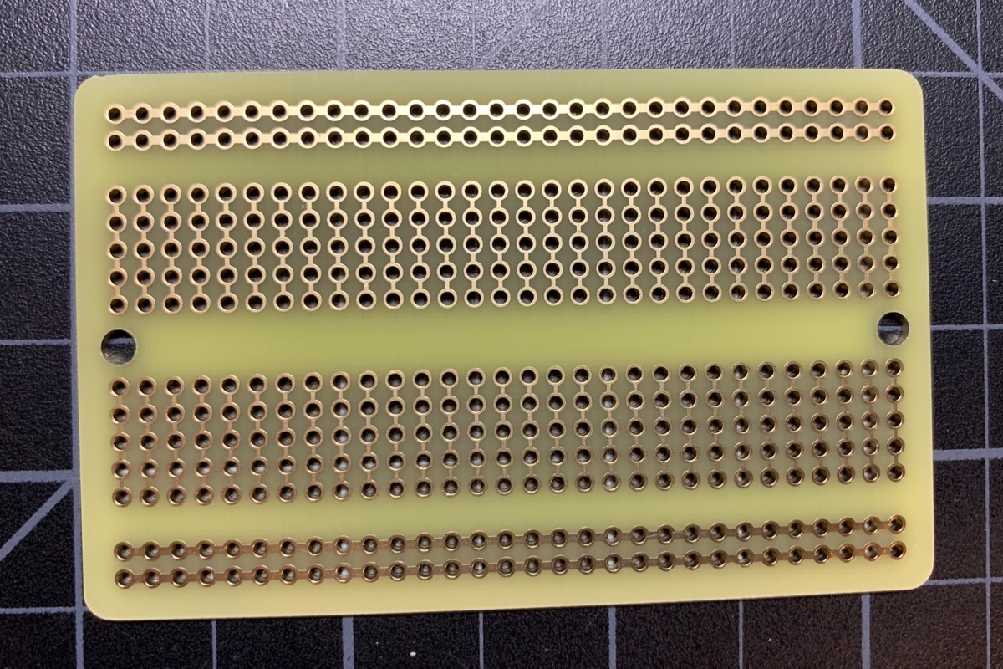
Perma-Proto Board

Slide 4
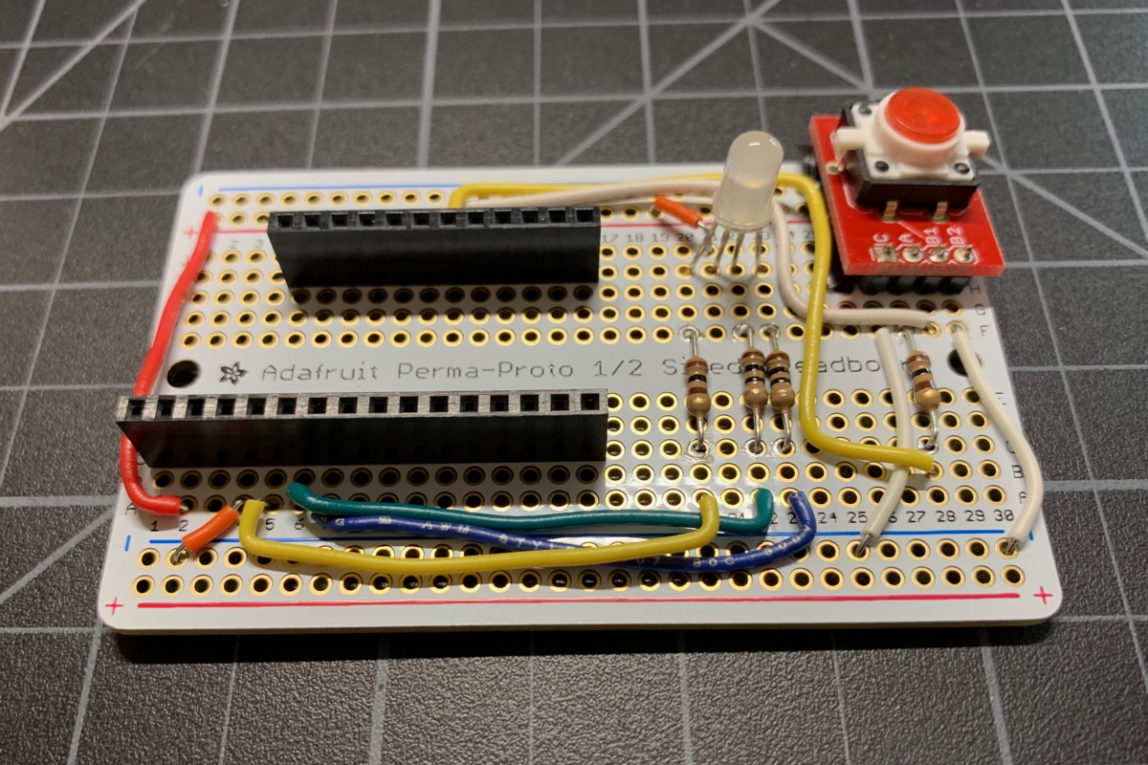
Perma-Proto Board

Slide 5
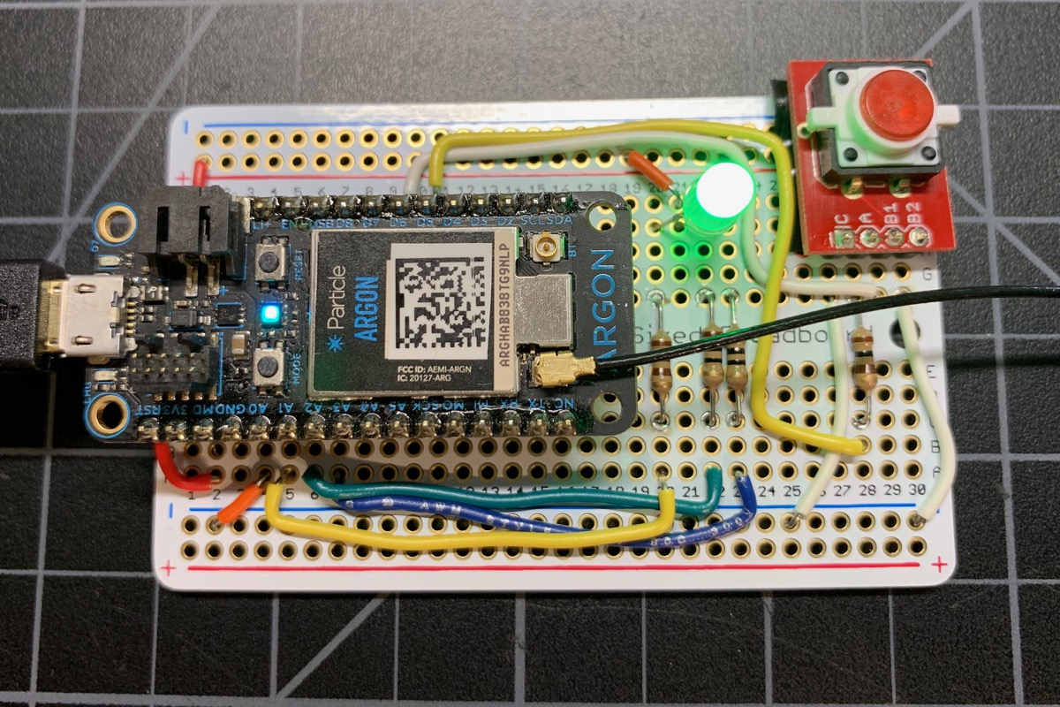
Perma-Proto Board

Slide 6
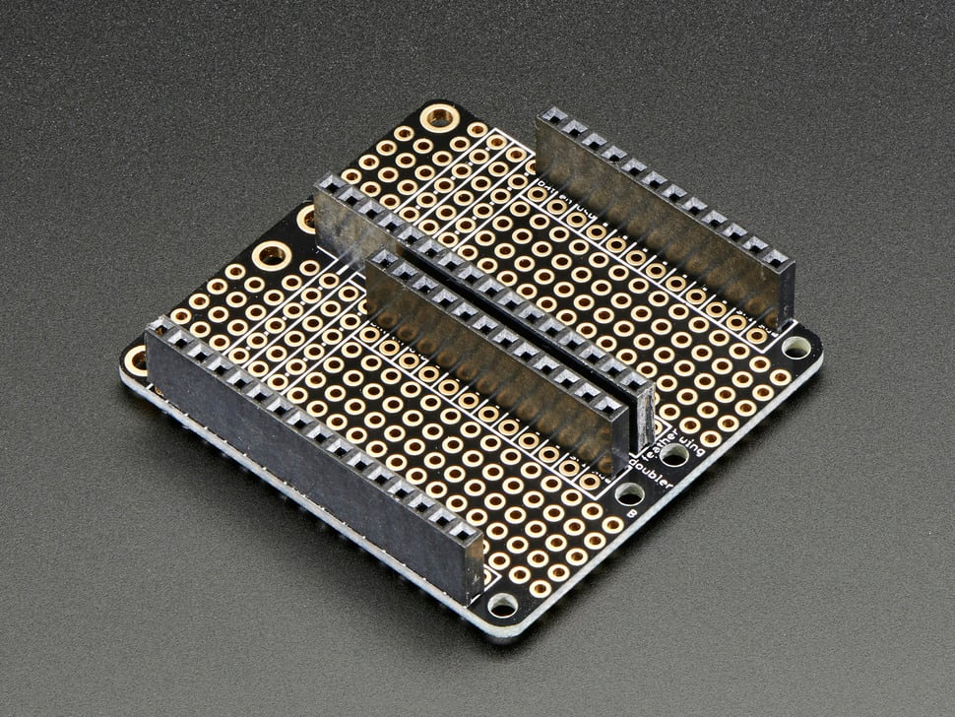
Feather Perma-Proto Board

Slide 7
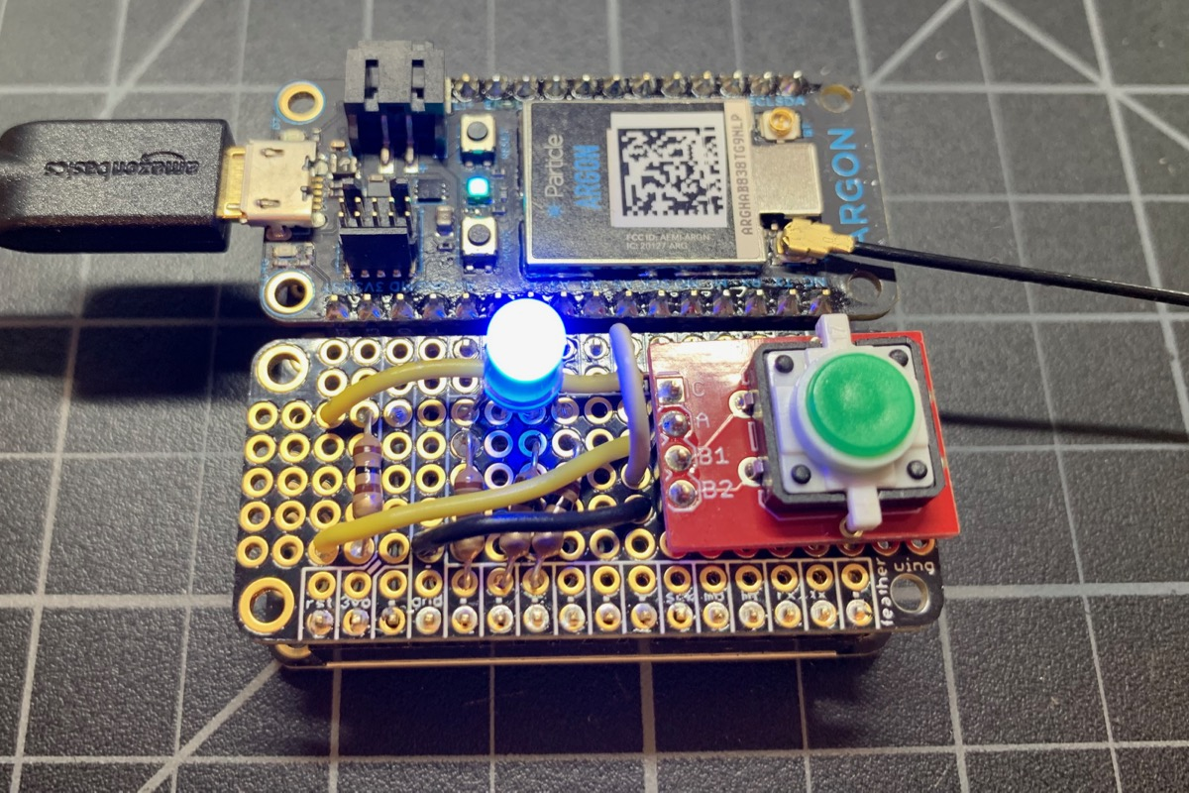
Feather Perma-Proto Board

Slide 8
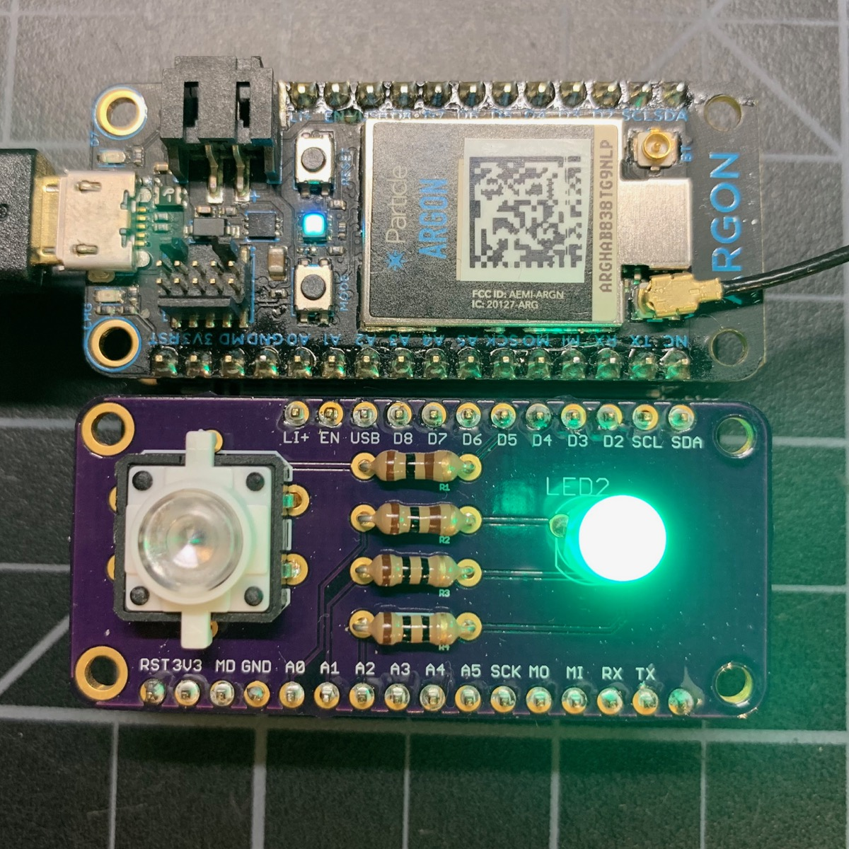
Feather Plated Through Hole PCB

Slide 9
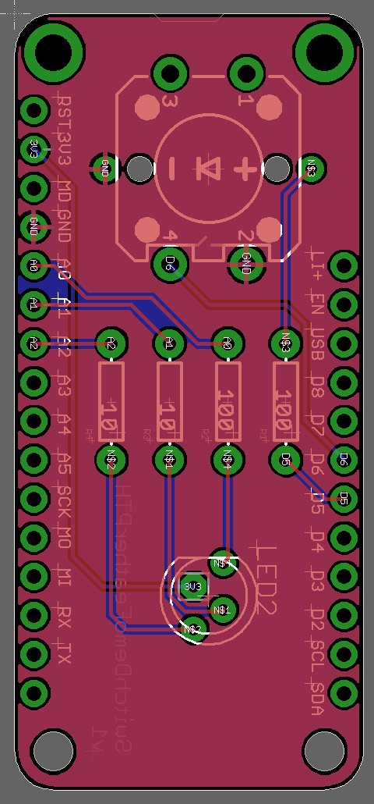
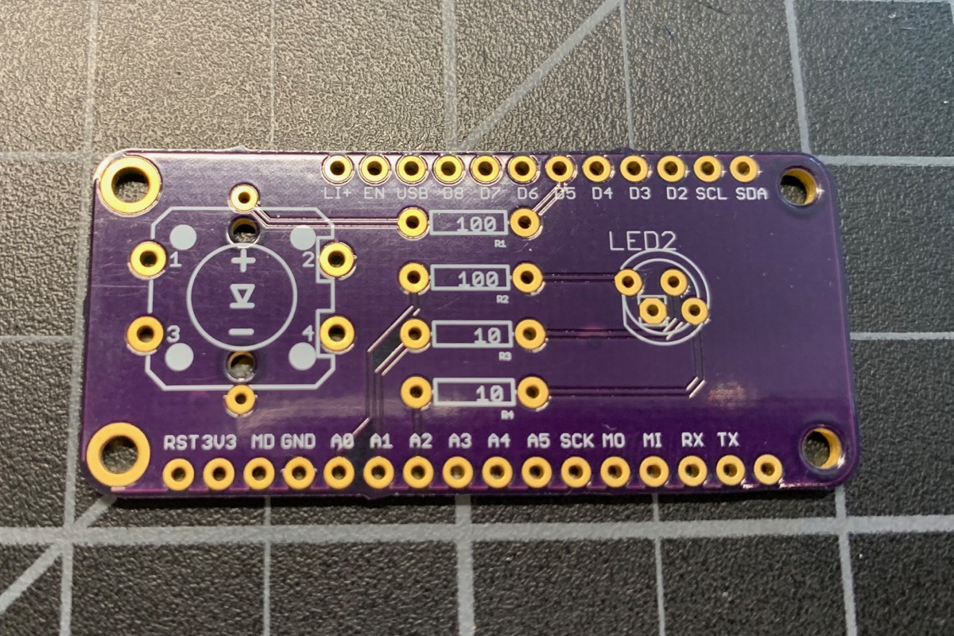
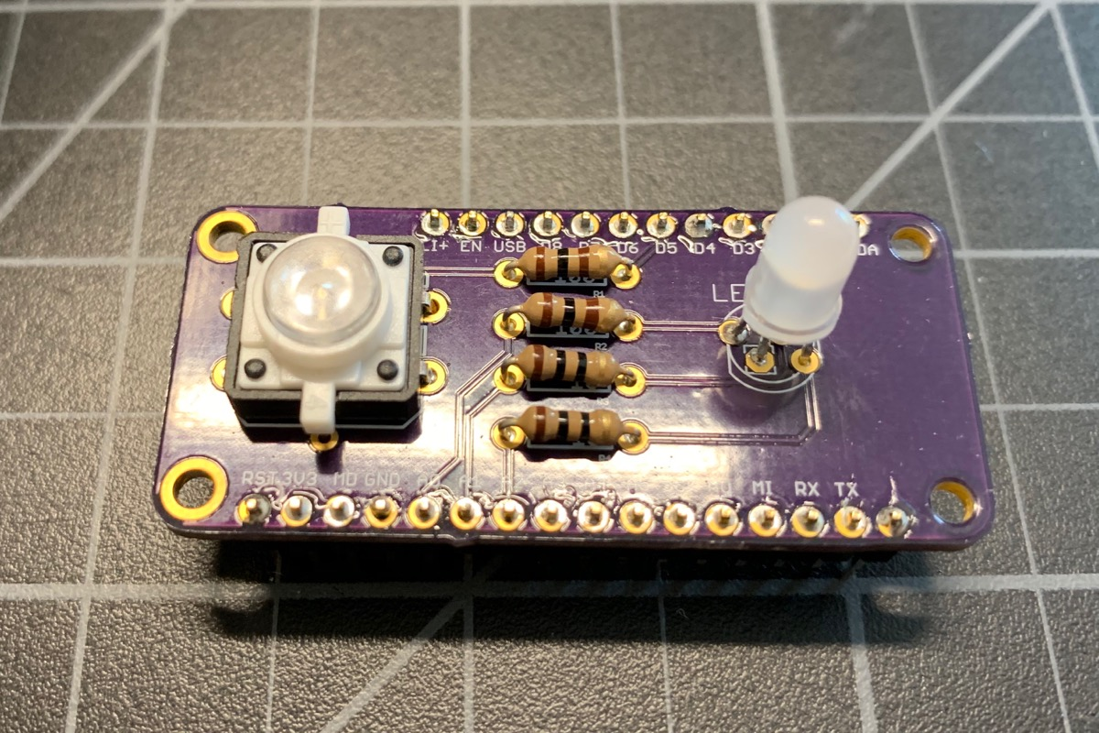
Feather Plated Through Hole PCB

Slide 10
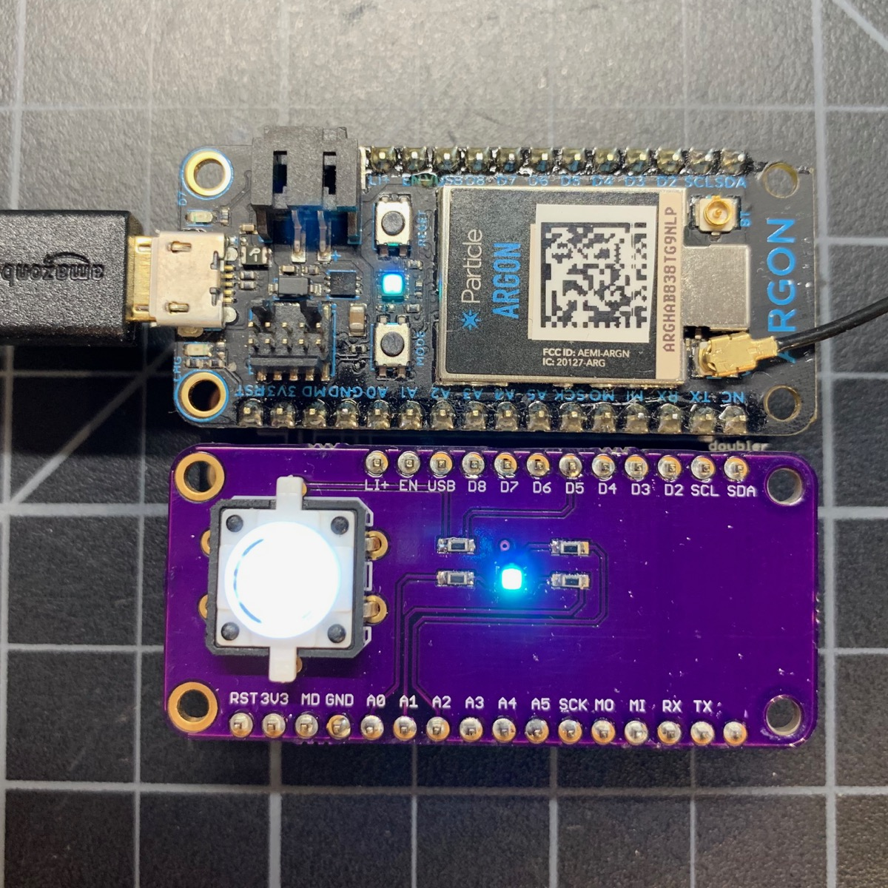
Feather Surface Mount Device SMD

Slide 11
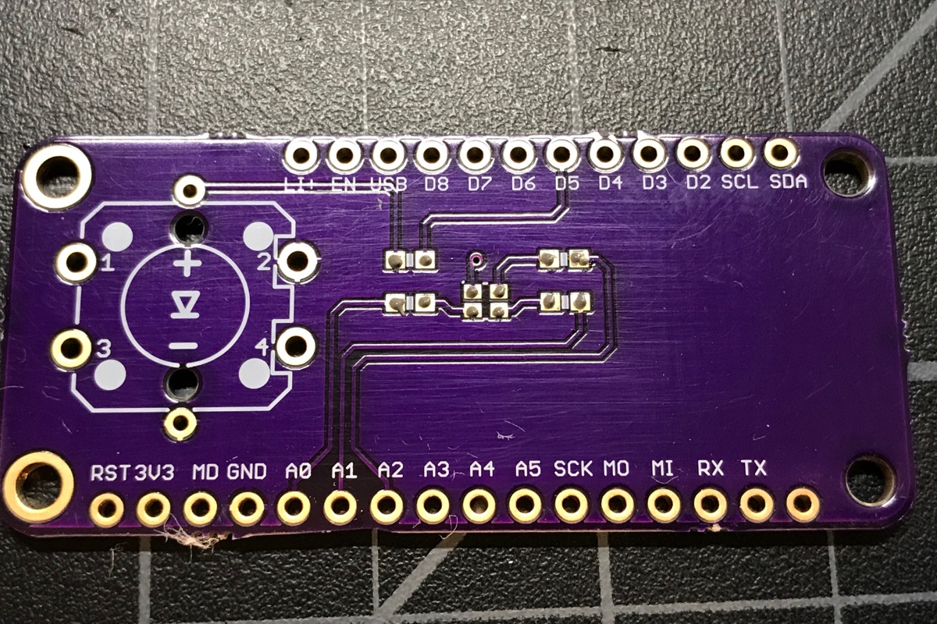
Feather Surface Mount Device SMD

Slide 12
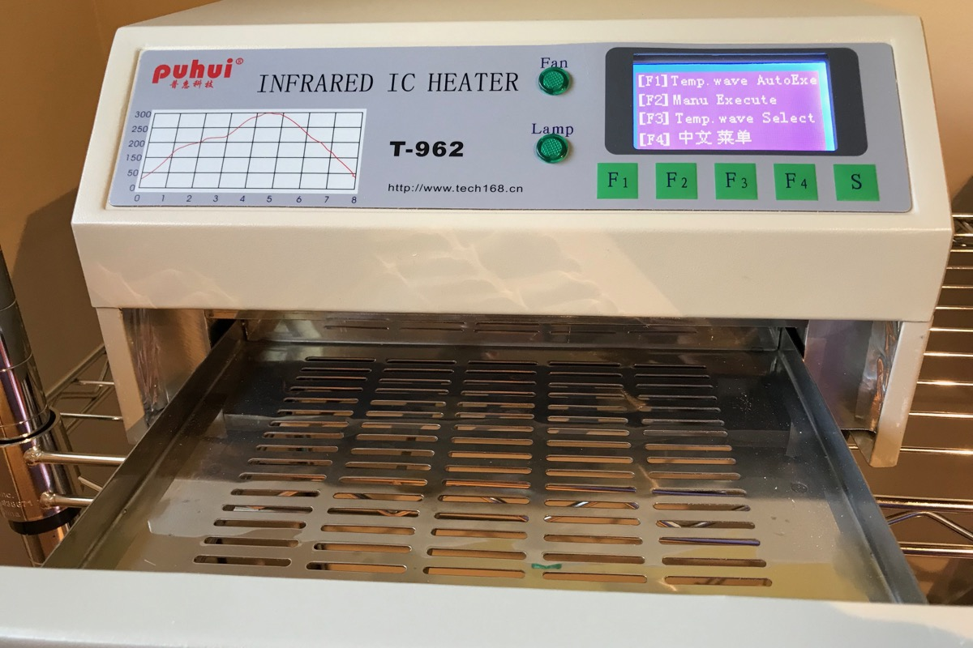
Feather Surface Mount Device SMD

Slide 13
Sources
https://docs.particle.io/hardware/expansion/beyond-prototyping/

